Slide 1


CMR TECHNICAL CAMPUS
UGC AUTONOMOUS
Accredited by NBA & NAAC with ‘A’ Grade
Approved by AICTE,New Delhi and affiliated to JNTU,Hyderabad Kandlakoya (V), Medchal Road, Hyderabad -501401, Telangana
Department of Computer Science and Engineering
Major Project Review
NETWORK INTRUSION DETECTION USING
SUPERVISED MACHINE LEARNING TECHNIQUE
WITH FEATURE SELECTION
BATCH NO-10
UNDER THE GUIDENCE OF :
Mrs .S.Aparna
(Assistant Professor)
PRESENTED BY :
VANGA BHAVANA : 207R1A05P5
JEERLA PRANAY : 207R1A05L4
DARIPELLI AKSHAY : 207R5A05K6

Slide 2
Contents
Abstract
Existing System
Disadvantages of Existing System
Proposed System
Advantages of Proposed System
Hardware and software requirements
Novelty of the project
Architecture
Modules
UML diagrams
Conclusion

Slide 3
Abstract
A novel supervised machine learning system is developed to the classify network traffic whether it is malicious or benign.
To find the best model considering detection success rate, combination of supervised learning algorithm and feature selection method have been used.
Through this study, it is found that Artificial Neural Network (ANN) based machine learning with wrapper feature selection outperform support vector machine (SVM) technique while classifying network traffic.
To evaluate the performance, NSL-KDD dataset is used to classify network traffic using SVM and ANN supervised machine learning techniques.
Comparative study shows that the proposed model is efficient than other existing models with respect to intrusion detection success rate.

Slide 4
Existing system
Before the adoption of supervised machine learning techniques and feature selection in network intrusion detection systems (NIDS), traditional approaches were employed to identify and mitigate security threats.
Rule-Based Systems(or)Signature-based detection: Rule-based systems were primarily reliant on predefined signatures or patterns of known attacks.
These signatures were manually crafted and updated regularly to keep up with emerging threats.
These systems worked well for detecting known attacks but struggled with new, unknown threats as they lacked the ability to adapt dynamically.

Slide 5
Disadvantages of existing system
Lack of adaptability to new and evolving threats.
High false positive rates, leading to alert fatigue.
Limited ability to detect sophisticated and unknown attacks.
Manual signature updates and rule configurations were time-consuming

Slide 6
Proposed System
For feature selection filter method and wrapper method have been used.
In filter method, features are selected on the basis of their scores in various statistical tests that measure the relevance of features by their correlation with dependent variable or outcome variable.
Wrapper method finds a subset of features by measuring the usefulness of a subset of feature with the dependent variable.
SVM classifies cases by finding a separator.
ANN uses technique called back propagation to adjust outcome with the expected result or class.

Slide 7
Advantages of Proposed System
Improved Security:effectively detecting and preventing malicious activities.
Accuracy in Detection:Utilizes supervised machine learning models to achieve high accuracy .
Feature Selection for Efficiency:Incorporates feature selection techniques to focus on the most relevant features, improving the efficiency.

Slide 8
Hardware Requirements
For Developing The Application The Following Are The Hardware Requirements:
SYSTEM : i3 OR ABOVE(currently used i5)
RAM : 4GB(currently 8)
HARD DISK : 40GB
Software Requirements
For Developing The Application The Following Are The Software Requirements:
OPERATING SYSTEM : WINDOWS 8 OR ABOVE
CODING LANGUAGE : PYTHON

Slide 9
Novelty of the project
Introduces a novel approach by incorporating advanced supervised machine learning techniques with a specific emphasis on feature selection.
This innovation addresses the limitations of current systems, offering improved efficiency, accuracy, and adaptability.
By strategically selecting relevant features, our system aims to enhance model interpretability and overall performance in network detection, marking a significant step forward in the field.

Slide 10
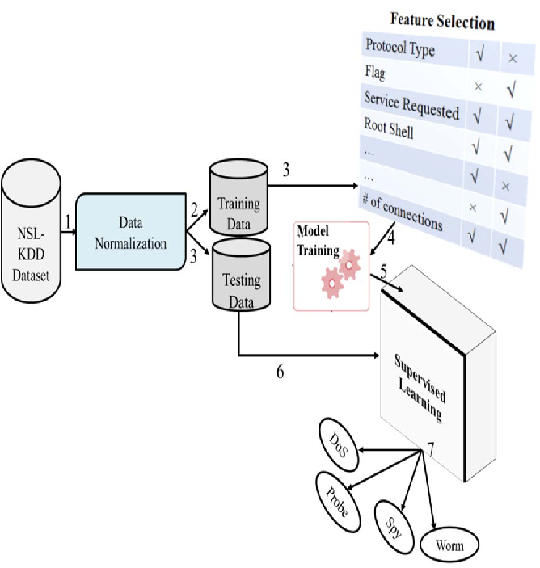
Architecture

Slide 11
Modules
Uploading the NSL and KDD dataset
PreProcess the dataset
Generate Training model
Run SVM Algorithm
Run ANN Algorithm
Upload Testdata and detect attack
Accuracy Graph

Slide 12
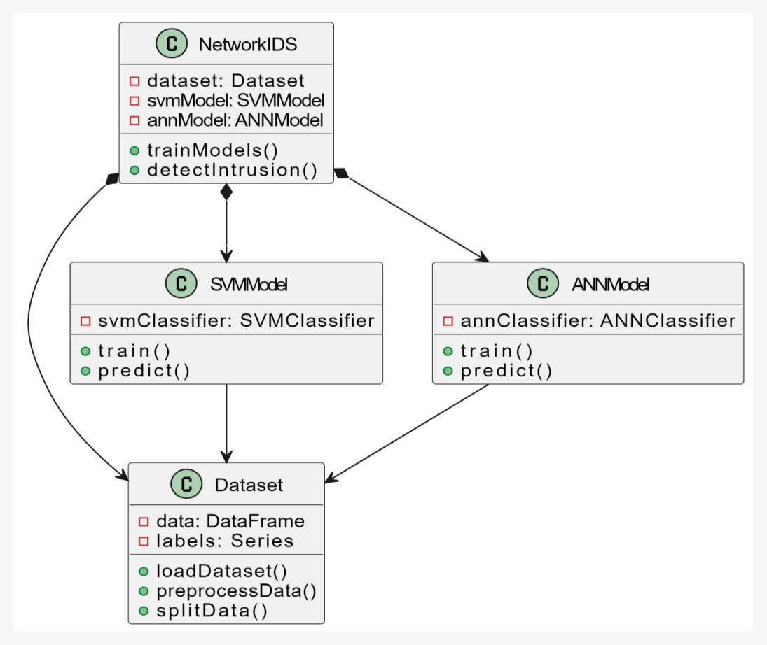
UML DIAGRAMS Class diagram:

Slide 13
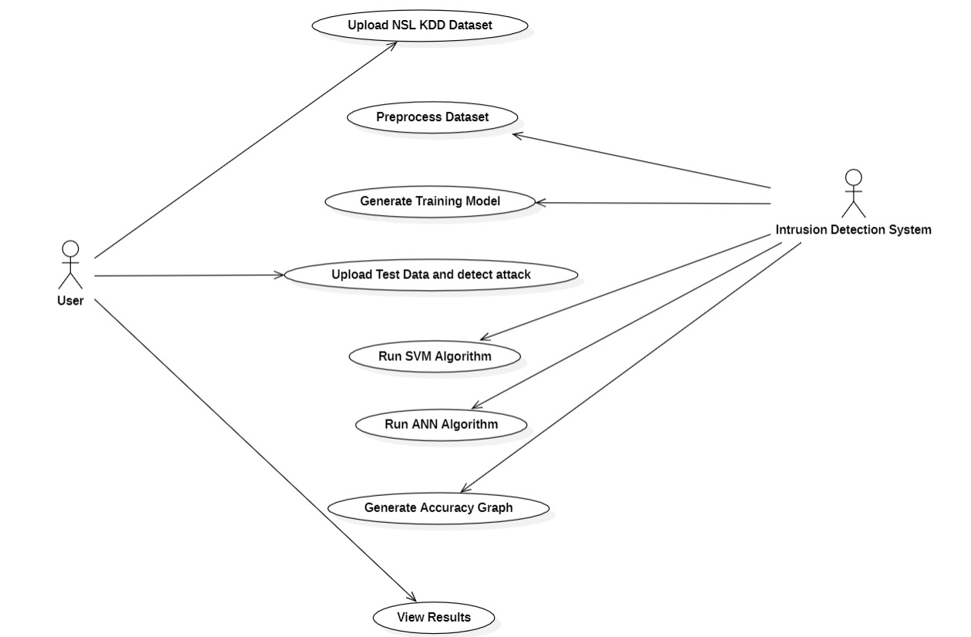
Usecase diagram

Slide 14
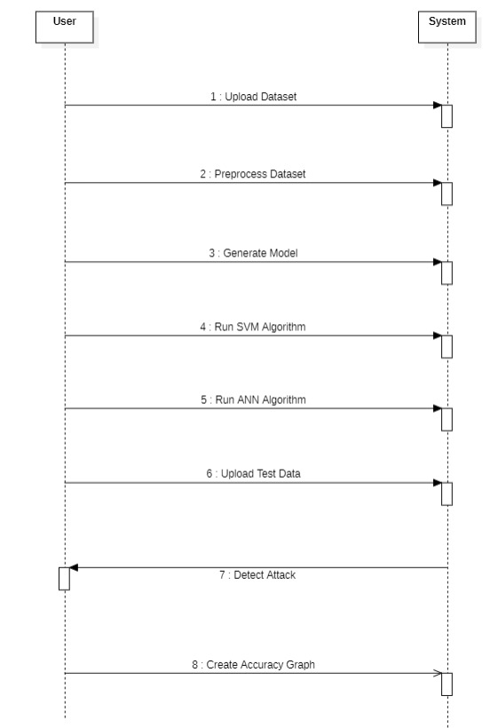
Sequence diagram

Slide 15
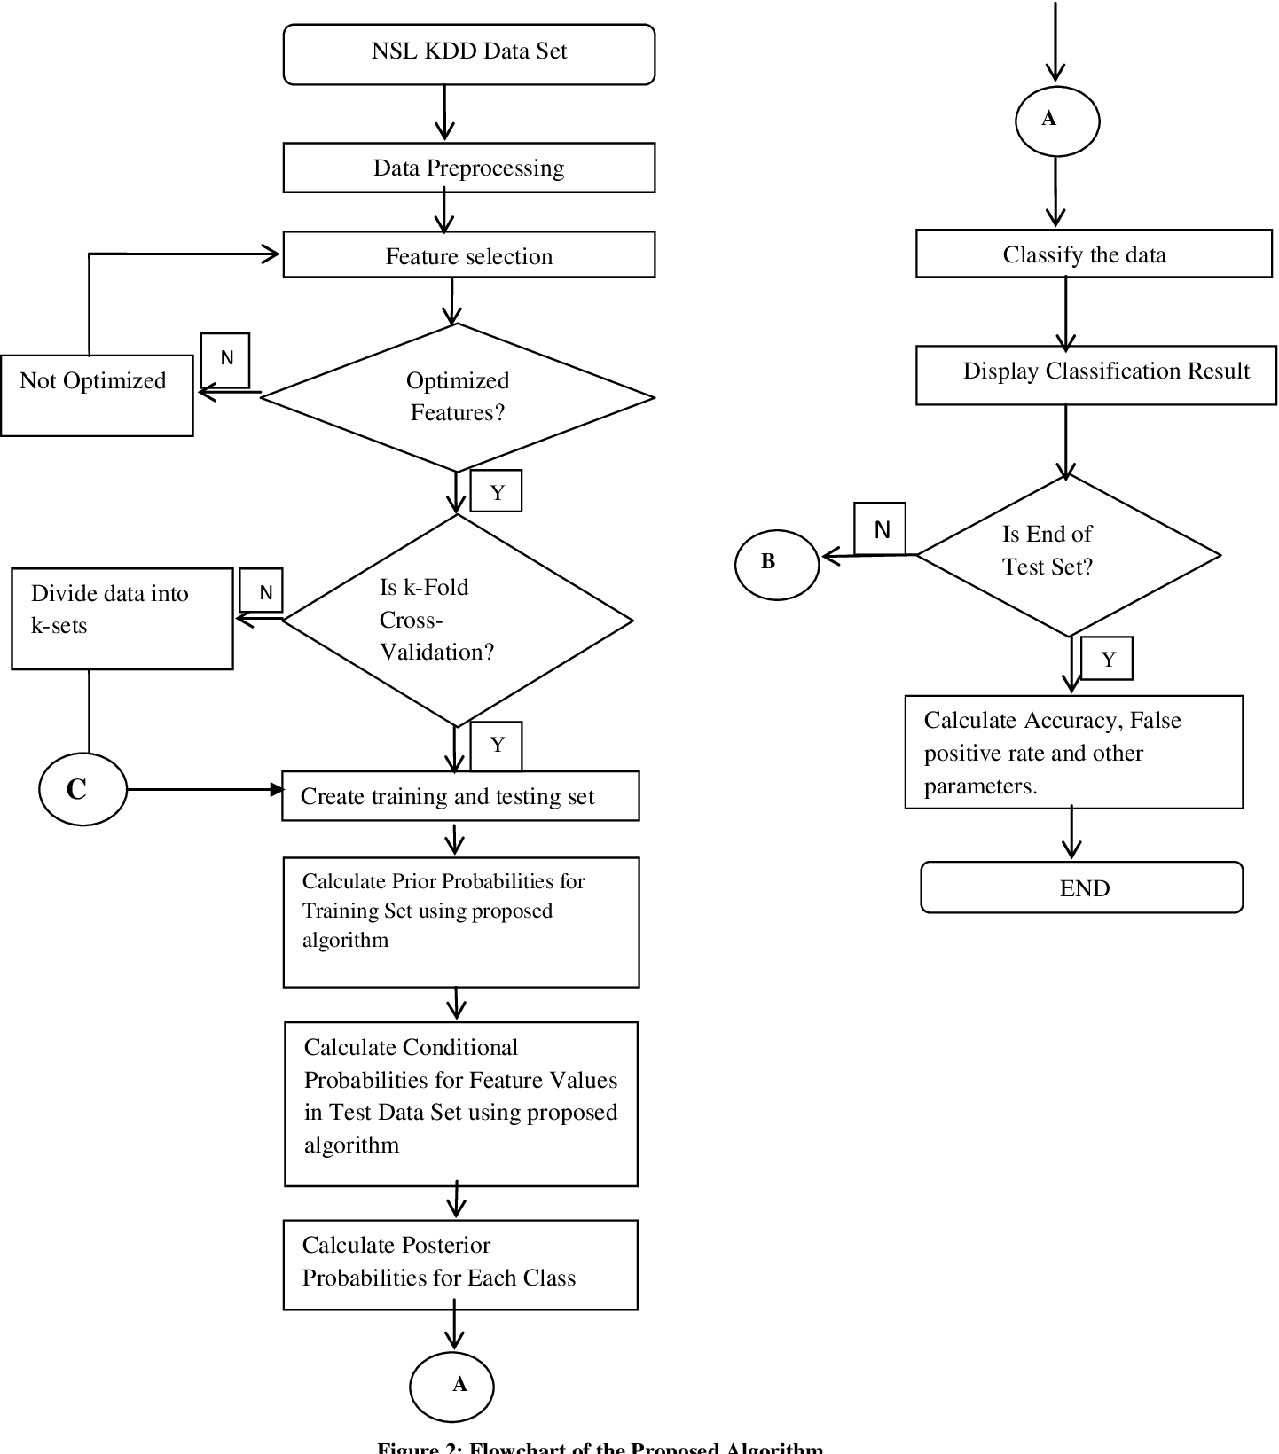
Activity diagram

Slide 16
Sample code
from tkinter import messagebox
from tkinter import *
from tkinter import simpledialog
import tkinter
from tkinter import filedialog
from imutils import paths
import matplotlib.pyplot as plt
import numpy as np
from tkinter.filedialog import askopenfilename
import numpy as np
import pandas as pd
from sklearn import *
from sklearn.model_selection import train_test_split
from sklearn import svm
from sklearn.metrics import accuracy_score

Slide 17
def runSVM():
text.delete('1.0', END)
global svm_acc
global classifier
global X, Y, X_train, X_test, y_train, y_test
total = X_train.shape[1];
#X_train1 = SelectKBest(chi2,15).fit_transform(X_train, y_train)
#X_test1 = SelectKBest(chi2,15).fit_transform(X_test,y_test)
text.insert(END,"Total Features : "+str(total)+"\n")
text.insert(END,"Features set reduce after applying features selection concept : "+str((total - X_train.shape[1]))+"\n\n")
cls = svm.SVC(kernel=‘rbf', class_weight='balanced', probability=True)
cls.fit(X_train, y_train)
text.insert(END,"Prediction Results\n\n")
prediction_data = prediction(X_test, cls)
svm_acc = cal_accuracy(y_test, prediction_data,'SVM Accuracy, Classification Report & Confusion Matrix')
classifier = cls
def runANN():
text.delete('1.0', END)
global ann_acc
global X, Y, X_train, X_test, y_train, y_test
total = X_train.shape[1];
X_train = SelectKBest(chi2,25).fit_transform(X_train, y_train)
X_test = SelectKBest(chi2,25).fit_transform(X_test,y_test)
text.insert(END,"Total Features : "+str(total)+"\n")
text.insert(END,"Features set reduce after applying features selection concept : "+str((total - X_train.shape[1]))+"\n\n")
model = Sequential()

Slide 18
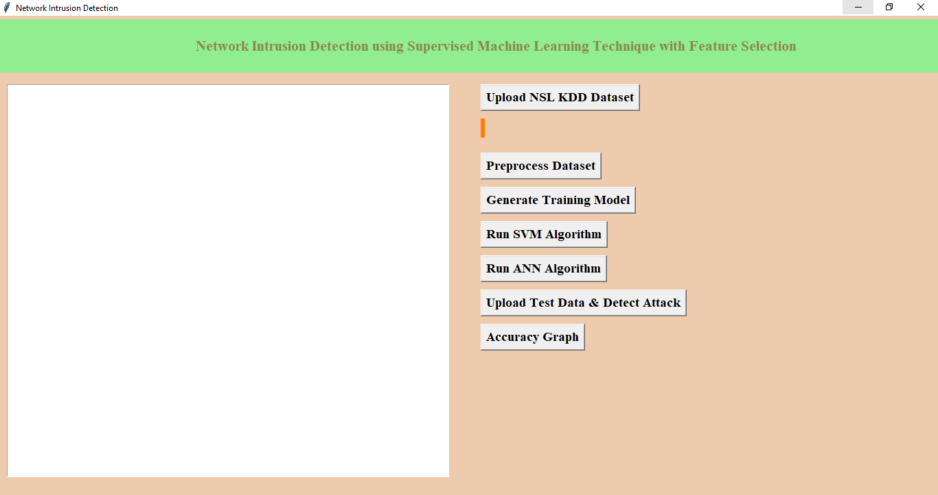
Results
In the above click Shows the contents to execute Network Intrusion Detection Using Supervised Machine Learning Technique with Feature Selection.

Slide 19
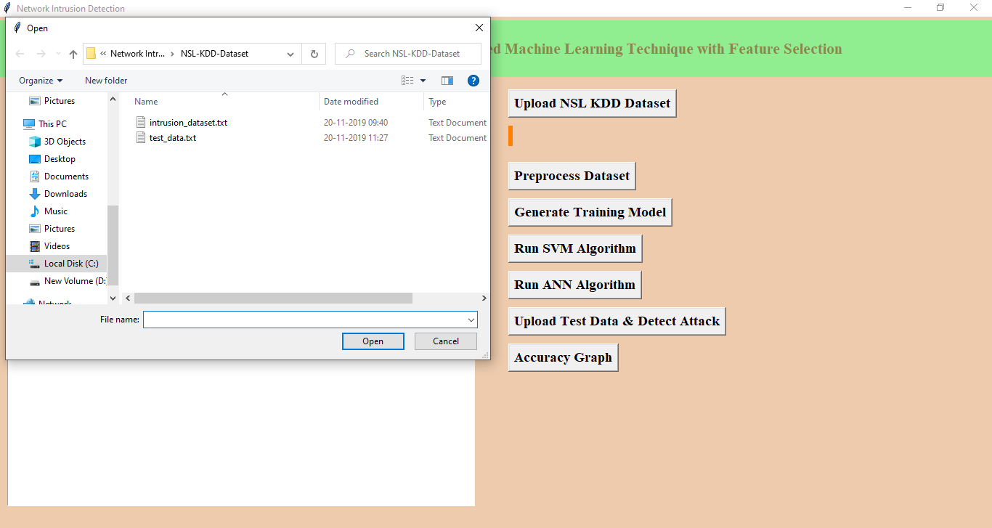
In above screen we are uploading ‘intrusion_dataset.txt’ file, after uploading dataset will get below screen

Slide 20
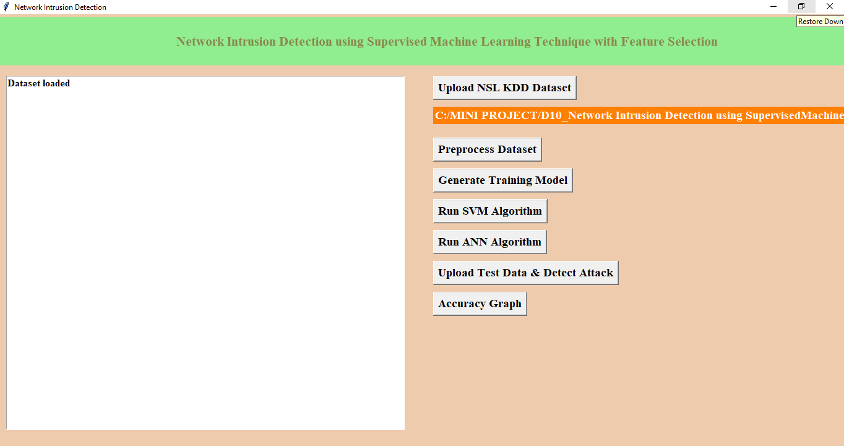
Now click on ‘Pre-process Dataset’ button to clean dataset to remove string values from dataset and to convert attack names to numeric values

Slide 21
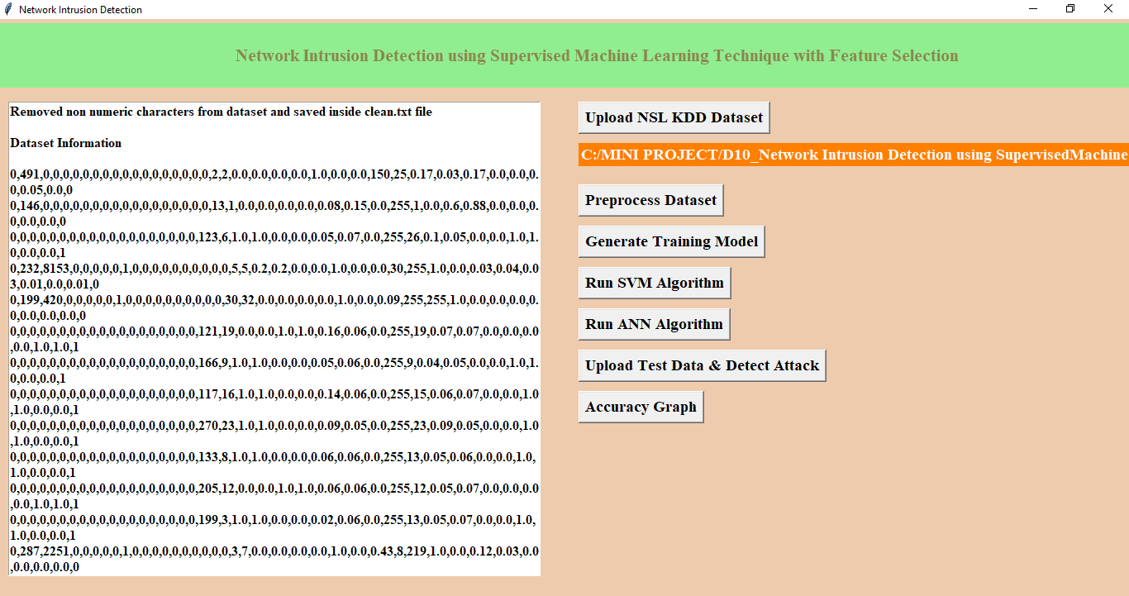
After pre-processing all string values removed and convert string attack names to numeric values such as normal signature contains id 0 and anomaly attack contains signature id 1.
Now click on ‘Generate Training Model’ to split train and test data to generate model for prediction using SVM and ANN

Slide 22
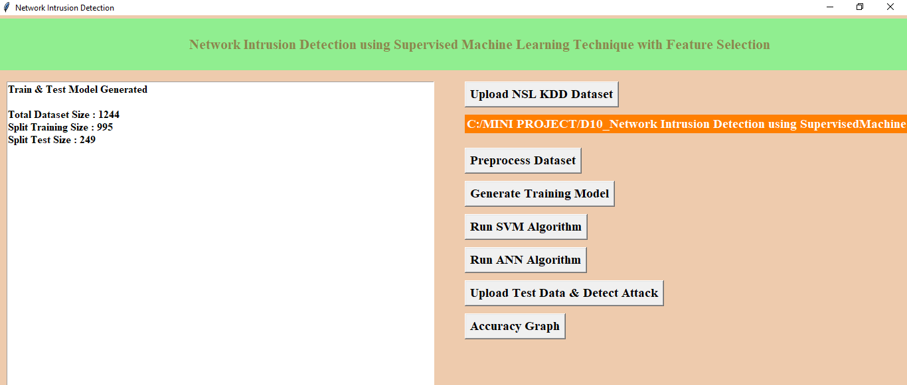
In above screen we can see dataset contains total 1244 records and 995 used for training and 249 used for testing. Now click on ‘Run SVM Algorithm’ to generate SVM model and calculate its model accuracy

Slide 23
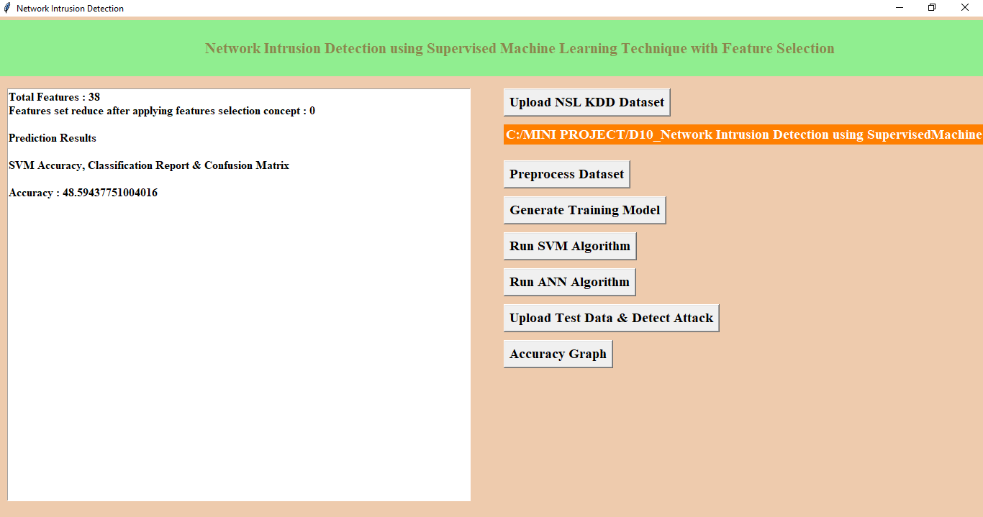
In above screen we can see with SVM we got 84.73% accuracy, now click on ‘Run ANN Algorithm’ to calculate ANN accuracy.

Slide 24
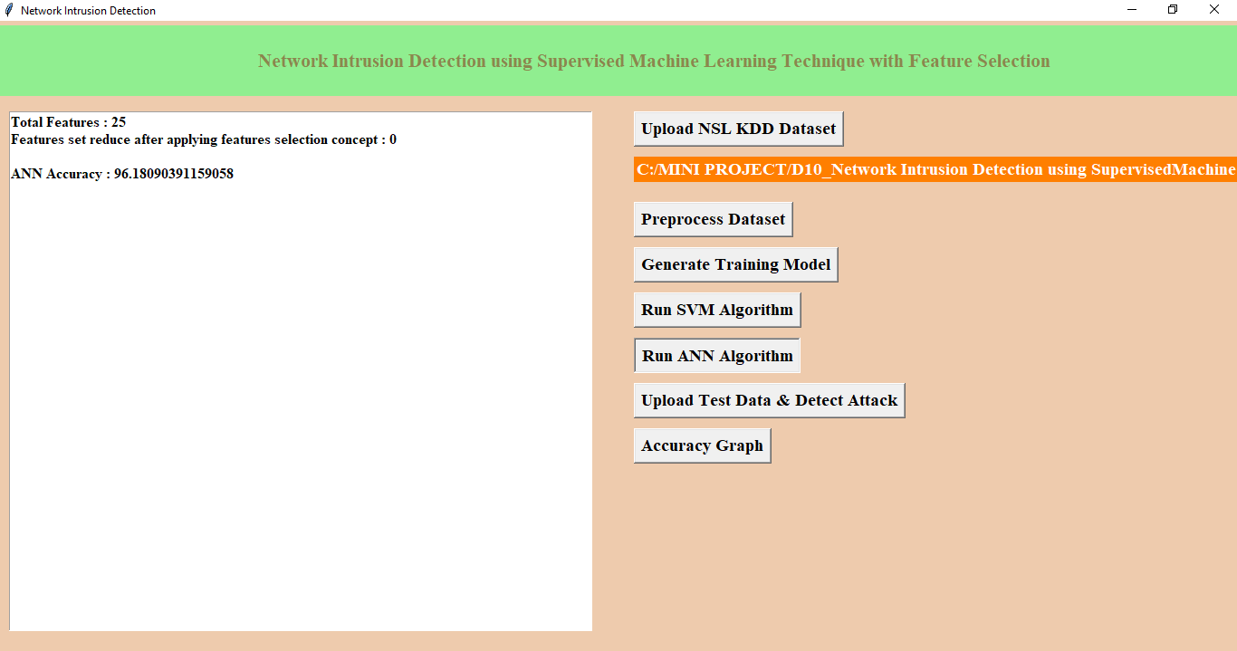
In above screen we got 96.18% accuracy, now we will click on ‘Upload Test Data & Detect Attack’ button to upload test data and to predict whether test data is normal or contains attack. All test data has no class either 0 or 1 and application will predict and give us result. See below some records from test data

Slide 25
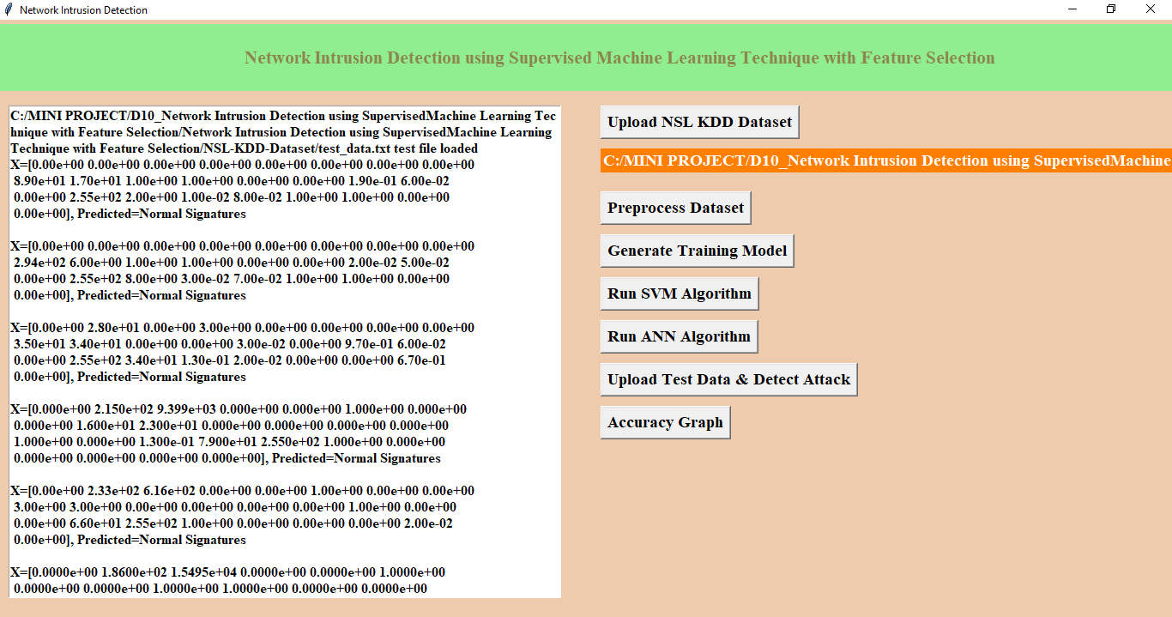
In above screen for each test data we got predicted results as ‘Normal Signatures’ or ‘infected’ record for each test record. Now click on ‘Accuracy Graph’ button to see SVM and ANN accuracy comparison in graph format

Slide 26
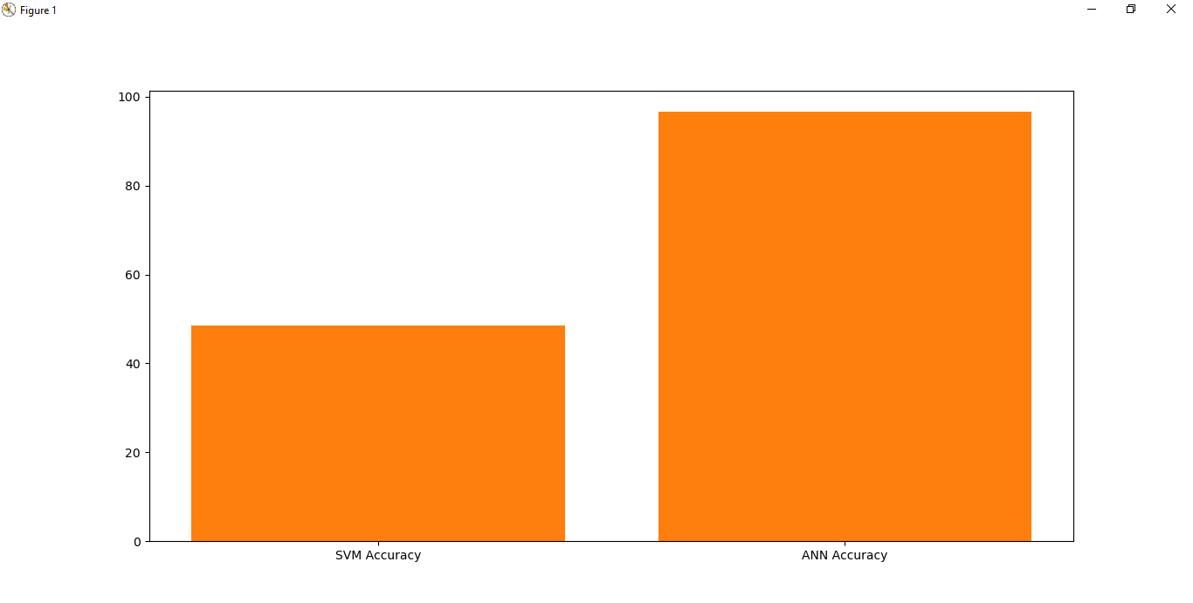
From above graph we can see ANN got better accuracy compare to SVM, in above graph x-axis contains algorithm name and y-axis represents accuracy of that algorithms .

Slide 27
Conclusion
We have concluded that different machine learning models using different machine learning algorithms and different feature selection methods to find a best model.
The analysis of the result shows that the model built using ANN and wrapper feature selection outperformed all other models in classifying network traffic correctly with detection rate of 96.18%
By this project we made a innvoaticve approach for detecting the network intrusion

Slide 28
Future Scope
Advanced Algorithm Exploration: Investigate advanced supervised learning algorithms beyond the initial model to enhance detection accuracy and efficiency.
Feature Engineering Research: Conduct further research on feature engineering techniques to identify and extract more informative features for better network anomaly detection.
Continuous Model Monitoring and Updating: Develop mechanisms for continuous monitoring of model performance in production environments and automated updating to adapt to changing network dynamics and emerging threats.

Slide 29
References
H. Song, M. J. Lynch, and J. K. Cochran, “A macro-social exploratory analysis of the rate of interstate cybervictimization,” American Journal of Criminal Justice, vol. 41, no. three, pp. 583–601, 2016.
P. Alaei and F. Noorbehbahani, “Incremental anomaly- based intrusion detection system using limited labeled data,” in Web Research (ICWR), 2017 3th International Conference on, 2017, pp. 178–184.
Srinivas Mukkamala, Guadalupe Janoski, Andrew Sung Intrusion Detection: Support Vector Machines and Neural Networks.
Wei Li “Using Genetic Algorithm for NetworkIntrusion Detection.
Cheng, Tay, &Huang, 2012 “Online sequential extreme learning Machine”(OS-ELM).
Liu, Chen, Liao, & Zhang, “Intrusion detection techniques”

Slide 30
Thank you.

